Slide 1
Lecture 1 – Arduino Basics
This lecture will introduce you to the Arduino platform as well as basic programming constructs leading up to blinking leds!
Presented by Sebastian Goscik

Slide 2

About me
Name: Sebastian “The Crab” Goscik
Email: sg00298@surrey.ac.uk
EARS Electronics Officer
Projects:
ERNIE (EARS Robotic Navigator and Intrepid Explorer)
EARS Ordering system
Custom V-USB Development board (Arduino compatible)
Android app with 500,000+ Total installs.
Many more at http://www.goscik.com
Volunteer work:
Headstart – Weeklong course for sixthformers. ERNIE was created specifically for this event.
Teaching – Such as this very class

Slide 3

What is
Electronics and Amateur Radio Society
Pre-Surrey society with a heritage in amateur radio and space tech
Technical society with a focus on member projects and the maker community
The main things we provide are our workshop (“The Shack”) and support for your projects beyond this course
Email: ussu.ears@surrey.ac.uk

Slide 4
Requirements and assumptions for the course
A laptop with the Arduino software installed.
Windows, Mac OS X and Linux versions are available at: http://arduino.cc/en/Main/Software
Windows versions may require administrator access to install drivers.
As we go along, the programming constructs you need to know will be taught.
If you have any issues please ask one of the demonstrators and they will be more than happy to help you.

Slide 5
Course Structure
A3 - Exploring serial communication
(Friday 14th November 6-8pm)
UART to PC
SPI (using SPI temp sensor)
I2C (using I2C temp sensor)
A4 - Advanced features Arduino
(Friday 28th November 6-8pm)
Shift register for more IO
Interrupts to speed up code
Timer interrupts
EEPROM
A5 - Final project (Friday 12th December 6-9pm)
Put your newfound Arduino skills to use in the final project.
A1 - Basic Arduino introduction
(Wednesday 22 October 6-8pm)
What is an Arduino and what can it do.
IDE feature guide
Explanation of Arduino sketch structure
Basic programming Blink on board LED
Blink an external LED
A2 - Exploring other pin functions
(Friday 31st October 6-8pm)
Get button input to toggle a LED
Analogue read using a potentiometer
Analogue Write to dim a LED
Tone to make sounds with a buzzer
Notes:
SORT INTO PAIRS

Slide 6
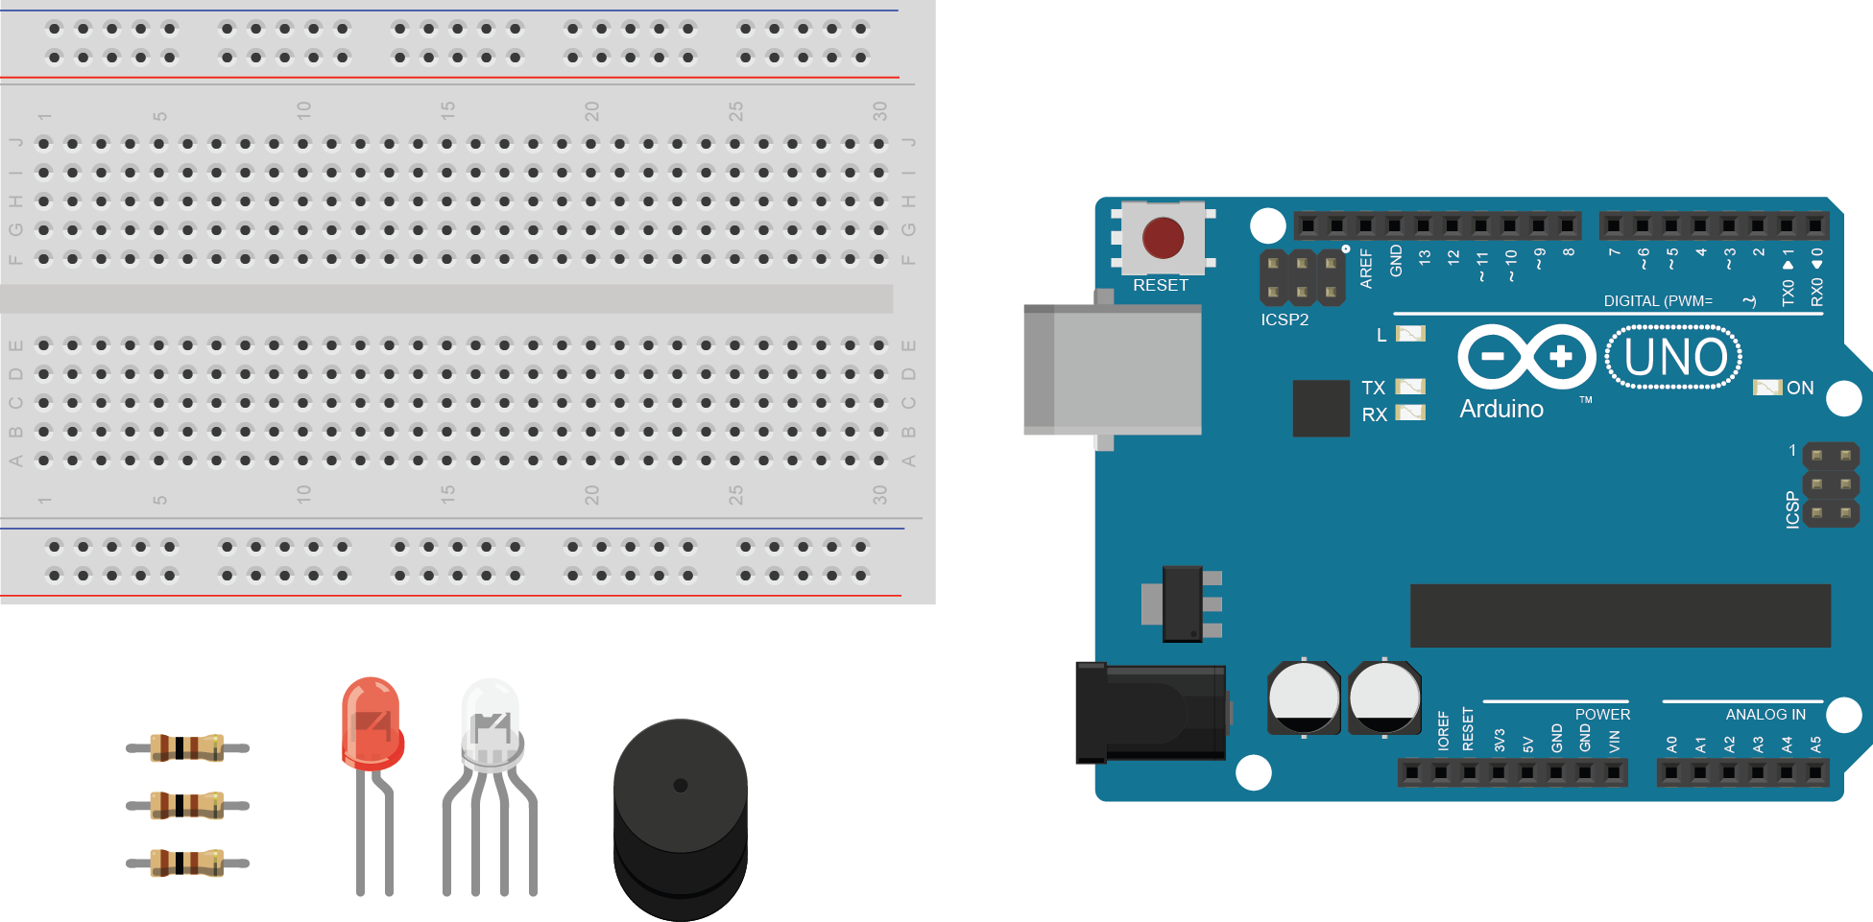
Kit contents
1x Breadboard
1x LED
1x RGB LED
1x Buzzer
3x 100R Resistors
1x USB Cable
1x Arduino

Slide 7
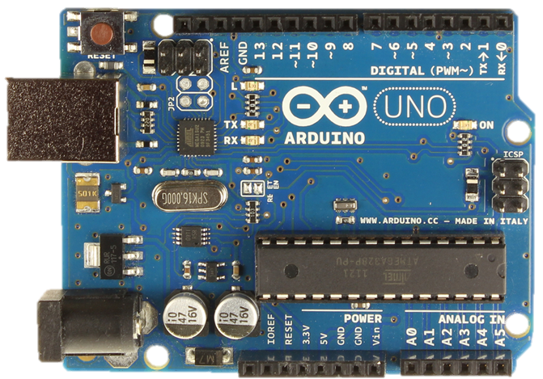
What is an Arduino?
Features
14 Digital I/O pins
6 Analogue inputs
6 PWM pins
USB serial
16MHz Clock speed
32KB Flash memory
2KB SRAM
1KB EEPROM

Slide 8
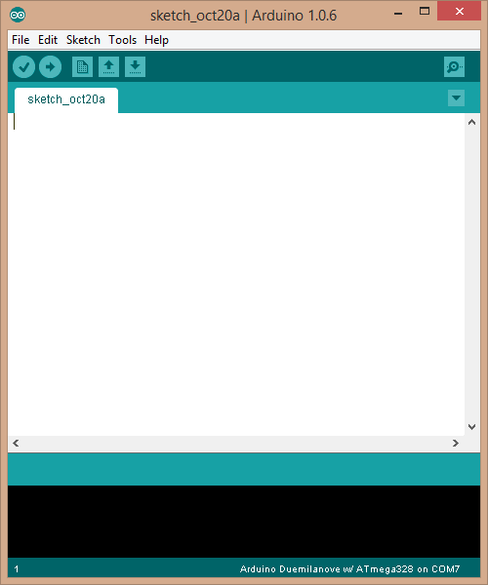
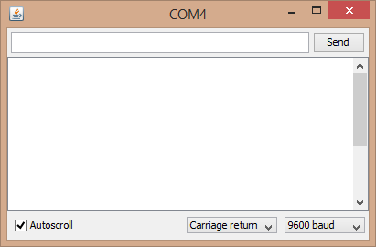
The Arduino IDE
The main features you need to know about are:
Code area: This is where you will type all your code
Info panel: This will show any errors during compiling or uploading code to your Arduino
Verify: This allows you to compile your code to code the Arduino understands. Any mistakes you have made in the syntax of your code will be show in the info pannel
Upload: This does the same as verify but will then send your code to your Arduino if the code is verified successfully
Serial Monitor: This will open a window that allows you to send text to and from an Arduino. We will use this feature in later lectures.

Slide 9
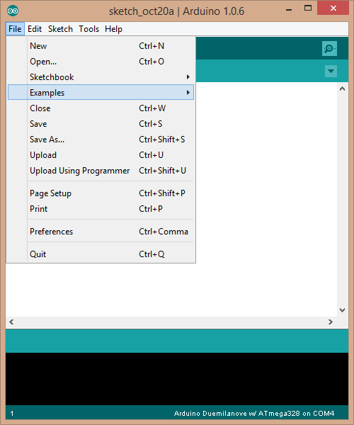
The Arduino IDE
By far one of the most valuable part of the Arduino software is its vast library of example programs. All features of the Arduino are demonstrated in these.
Optional libraries usually add their own examples on how to use them.
Arduino shields will often come with their own libraries and therefore their own examples.
If these examples don’t cover what you need….Google it!

Slide 10
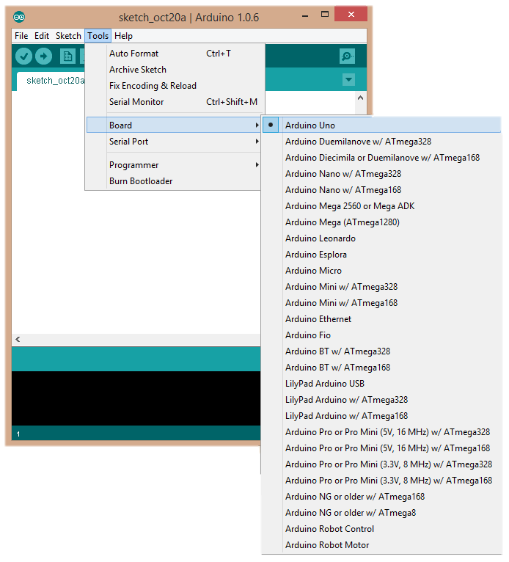
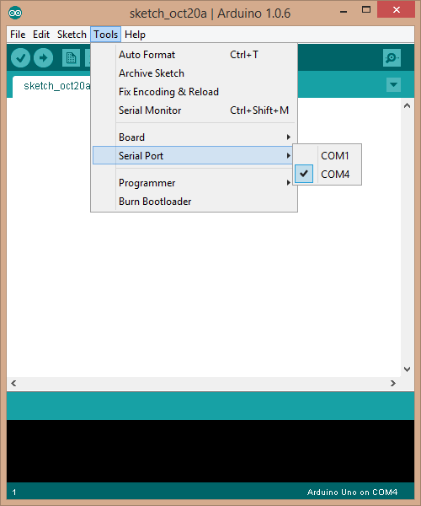
Before we begin coding
Notes:
Mention device manager for COM ports

Slide 11
Structure of an Arduino “sketch”
void setup()
{
// put your setup code here, to run once:
}
void loop()
{
// put your main code here, to run repeatedly:
}
NB: A copy of this can be found in File>Examples>1. Basics>BareMinimum
Notes:
Before you show the NB, switch to desktop view and do it together with them

Slide 12

My first sketch ( By )
int onBoardLED;
void setup()
{
//Arduinos have an on-board LED on pin 13
onBoardLED = 13;
pinMode(onBoardLED, OUTPUT);
}
void loop()
{
digitalWrite(onBoardLED, HIGH);
delay(500); //delay measured in milliseconds
digitalWrite(onBoardLED, LOW);
delay(500);
}
Notes:
Explain then show programming
Dissect the code line by line:
Void = return type of the function. Tell them we will go into functions more later
Setup = fuction name
Int onBoardLED = 3 = A whole number variable called onBoardLED and we assign the value 13. This is like a name for a number much like algebra
; < must go on the end of every line that isn’t a function definition
pinMode =
digitalWrite =
Comment =
Delay =

Slide 13
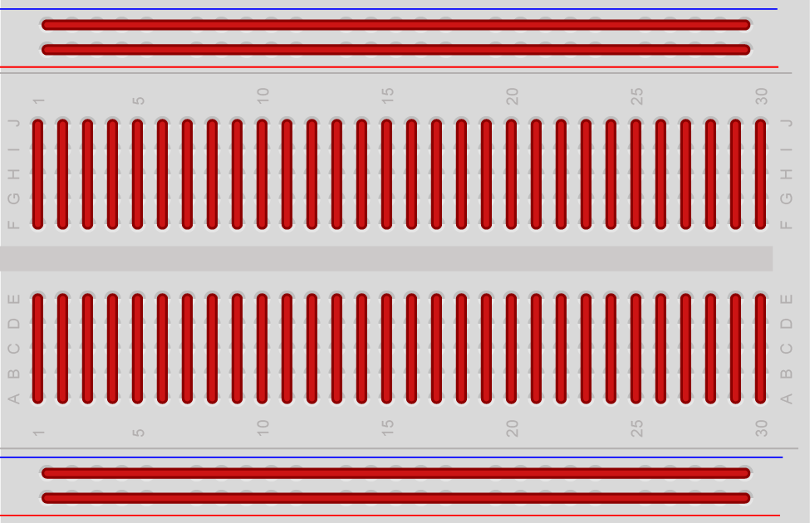
Breadboard
Notes:
Breadboard get their name from old circuits that where made by putting copper nails into bread cutting boards and wire was wrapped around them

Slide 14
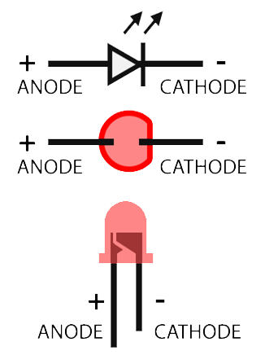
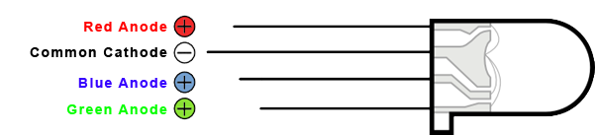
LEDs

Slide 15
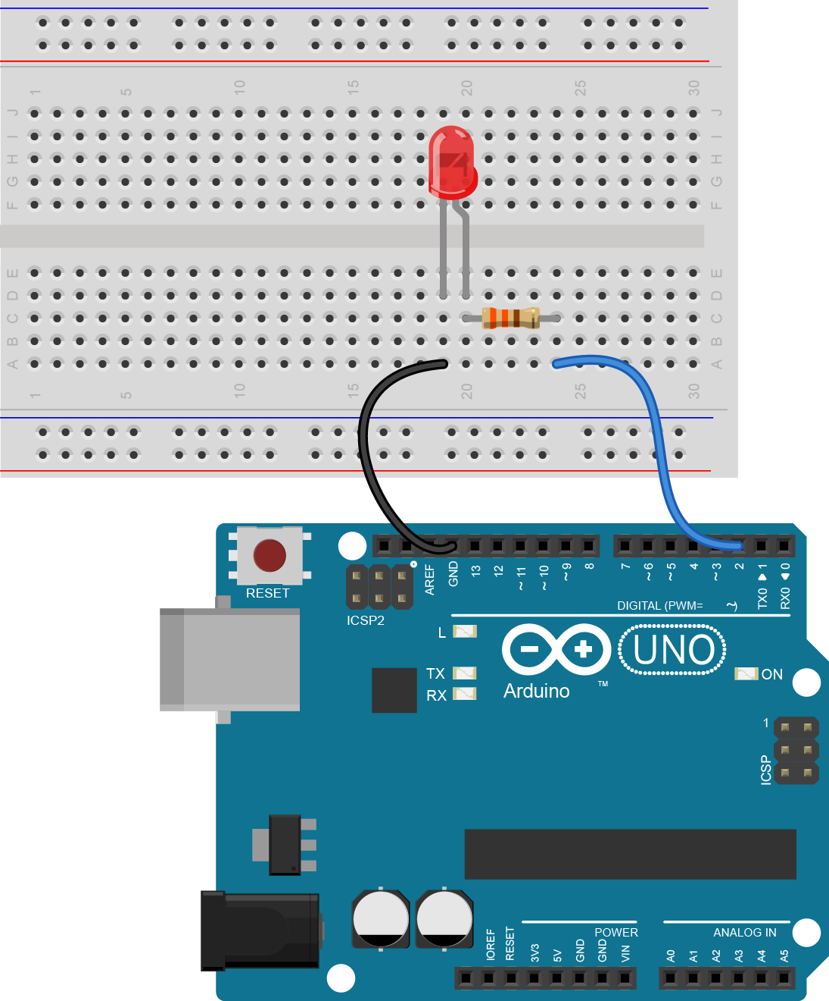
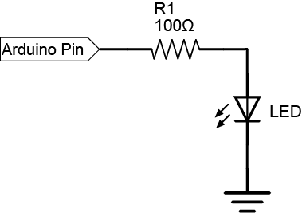
External LEDs
Try make an LED pin blink in a pattern on a pin of your choice

Slide 16
PWM – Pulse width modulation
PWM allows you to create a fake analogue signal by toggling a pin high and low. The amount of overall time the pin spends high effects the average voltage of the signal.
This works well for dimming LEDs so long as the frequency of pulses is faster than the eye can pick up
An Arduino UNO can only do PWM on pins:
3, 5, 6, 9, 10 and 11

Slide 17
PWM EXAMPLE
int ledPin;
void setup()
{
ledPin = 10;
//Note that PWM doesn't need a pinMode
}
void loop()
{
analogWrite(ledPin, 50);
delay(500);
analogWrite(ledPin, 255);
delay(500);
}
Notes:
Let them test the code themselves

Slide 18
Loopy loop LOOOOOOOPS!
For loop: Allows you to loop a certain number of times
Counter initialisation
Counter condition
What to do when loop iteration finishes
for (int counter = 0; counter<10; counter+=1)
{
//Do a barrel roll
}

Slide 19
Loopy loop LOOOOOOOPS!
While loop: Allows you to loop until a condition is met
Condition
while(digitalRead(10) == LOW)
{
//Such loop, many iteration, WOW!, much condition met
}
Notes:
Explain ==

Slide 20
Final Challenge
Task 1: Make the RBG LED cycle through 7 possible colours
Task 2: Make the LEDs fade from Red > Blue > Green > RED

